Slide 1
Project 1 Presentation
By Forrest Wong & Yead Al Ashrafi

Slide 2
Overview
Created an iPhone simulator using HTML and CSS
Files
- off.html (off.css)
- home.html (home.css)
- applemap.html
- appstore.html
- email.html (app.css)
- facetime.html
- text.html
- pokemon.html

Slide 3
Description
Off.html
The first page of the website which has shows an iPhone with a home button. Clicking the home button takes the user to the next page which is home.html
Home.html
This page contains apps for the iPhone.
Clicking on the app will take the user to the corresponding pages.
For time constraints, we created new pages only for six apps.
Other html Pages
When a particular app is clicked by the user in the home page, the user will be redirected to that app page.
The website does not have any further functions after the app pages
Clicking the home button on the iPhone will take the user back to the home page.

Slide 4
DEMO
http://codd.cs.gsu.edu/~fwong1/project1/off.html

Slide 5
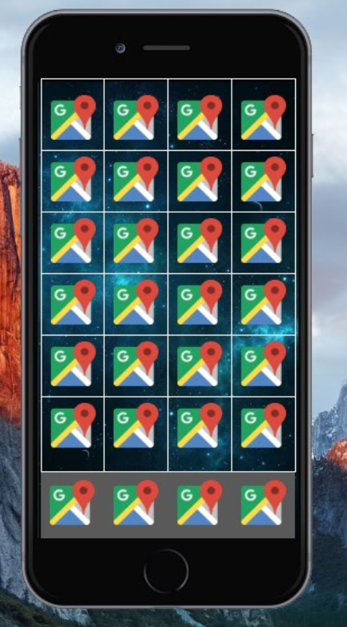
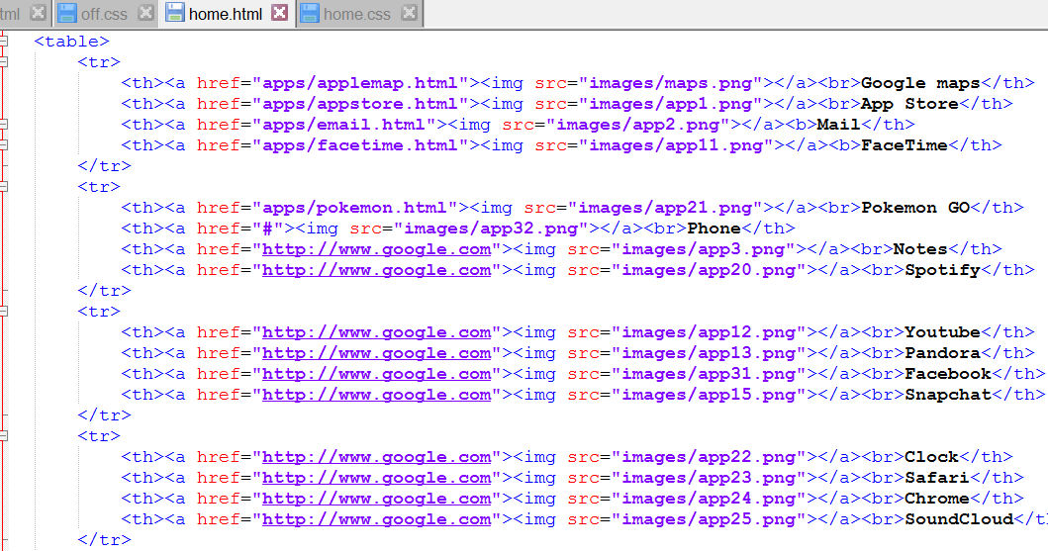
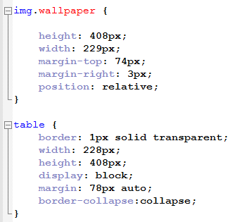

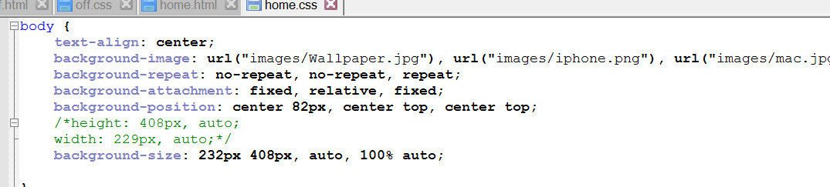
Behind the scenes
The background is done with overlapping pictures.
- The apps are actually the elements in the table.

Slide 6
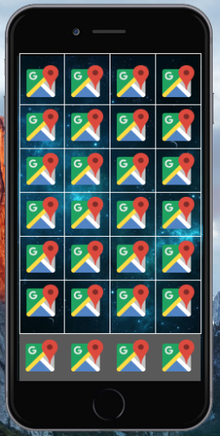
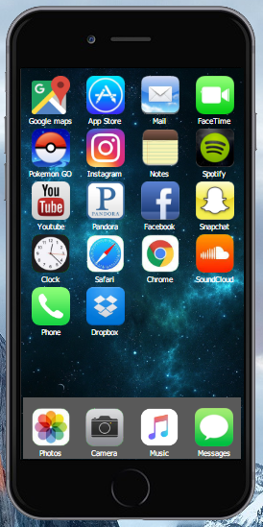
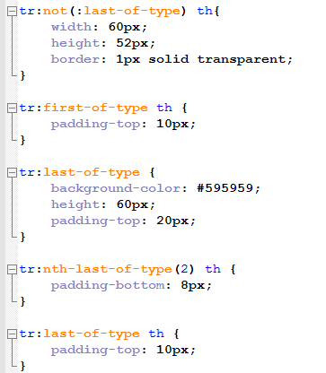
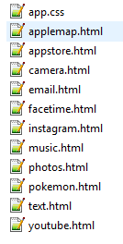
Behind the scenes

